Slide 1
Design & Analysis of Algorithms
Lecture # 7

Slide 2
Quick Sort
It is one of the fastest sorting algorithms known and is the method of choice in most sorting libraries.
Quicksort is based on the divide and conquer strategy. Here is the algorithm:

Slide 3
Quicksort
A[p…q]
≤
A[q+1…r]
Sort an array A[p…r]
Divide
Partition the array A into 2 subarrays A[p..q] and A[q+1..r], such that each element of A[p..q] is smaller than or equal to each element in A[q+1..r]
The index (pivot) q is computed
Conquer
Recursively sort A[p..q-1] and A[q+1..r] using Quicksort
Combine
The entire array is now sorted

Slide 4
QUICK SORT
Alg. : QUICKSORT(A, p, r)
if p < r
then q ← PARTITION(A, p, r)
QUICKSORT(A, p, q - 1)
QUICKSORT(A, q + 1, r)
The pivot is no longer included in any of the subarrays!!

Slide 5
PARTITION(array A, int p, int r)
0. Select Pivot and exchange it to first position of the array
1 x ← A[p]
2 q ← p
3 for s ← p + 1 to r
4 do if (A[s] < x)
5 then q ← q + 1
6 swap A[q] with A[s]
7 swap A[p] with A[q]
8 return q
Notes:
X is pivot, s is reading elements of array starting from second element since first element is pivot, p is first location and r is the last location of array A, q is at location that is less then pivot, q shows less than or equal to pivot value index, that is it is controlling the replacement (that which number to be swapped or not based on the pivot comparison) , actually q is controlling the pivot position that at he end will divide the array in two parts right part and left part of pivot. X is pivot value, q is pivot position controlling index, p is starting index, s scans numbers in the array

Slide 6
Example
5 | 3 | 8 | 6 | 4 | 7 | 3 | 1

Slide 7
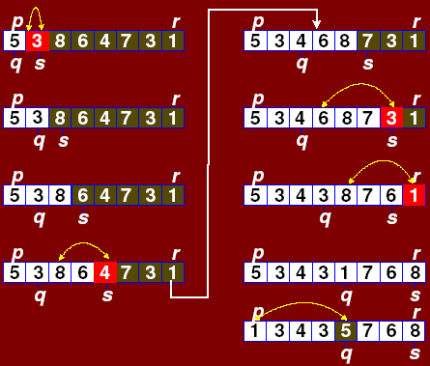

Slide 8
Analysis of Quick sort
The running time of quicksort depends heavily on the selection of the pivot. If the rank (index value) of the pivot is very large or very small then the partition (BST) will be unbalanced.
Since the pivot is chosen randomly in our algorithm, the expected running time is O(n log n).
The worst case time, however, is O(n²). Luckily, this happens rarely.

Slide 9
Analysis of Quick Sort
the for loop stops when the indexes cross, hence there are N iterations
swap is one operation – disregarded
Two recursive calls:
Best case: each call is on half the array, hence time is 2T(N/2)
Worst case: one array is empty, the other is N-1 elements, hence time is T(N-1)
T(N) = T(i) + T(N - i -1) + cN

Slide 10
Analysis of Quick Sort
The time to sort the file is equal to
the time to sort the left partition with i elements, plus
the time to sort the right partition with N-i-1 elements, plus
the time to build the partitions

Slide 11
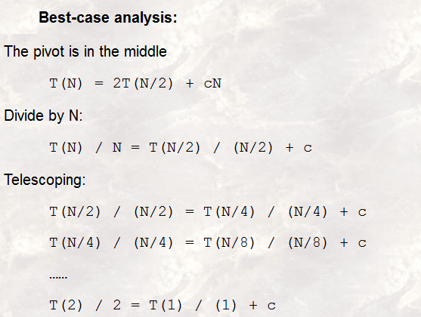
Notes:
Best case mean suppose pivot is middle number n it divides both lists in approx. equal halves.
C.N is time to merge N elements and vice versa
Constant C is used in Quick sort because at each iteration it sorts 1 element(Pivot) and so remaining iterations are (N-1) and vice versa

Slide 12
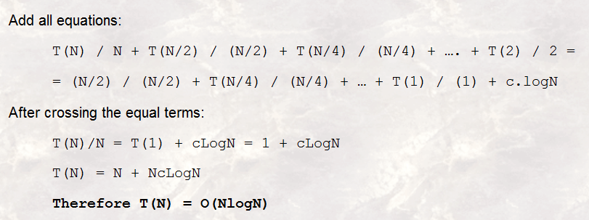
Notes:
T(1)=1 in quick sort since 1 elements is sorted and so this will move in combining the elements T
C is adding till LogN times so CLogN

Slide 13
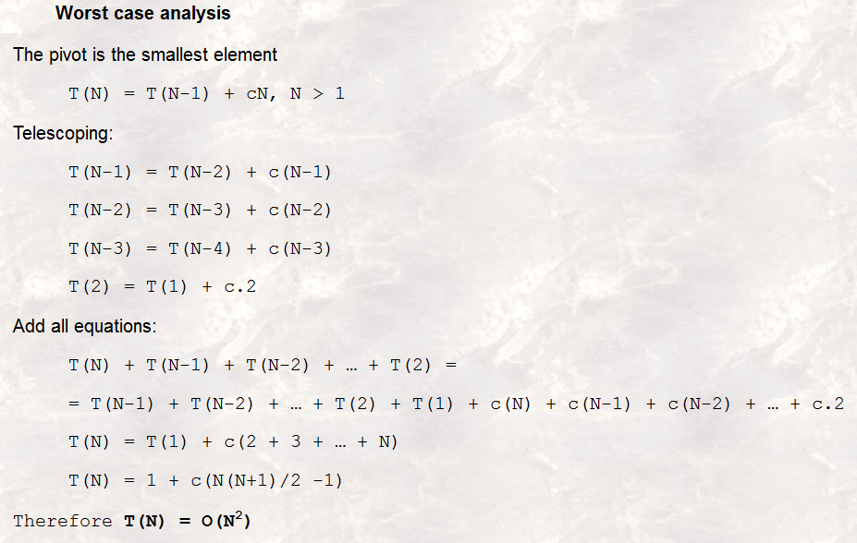
(Cancel similar terms on both sides)
Notes:
cN is time to divide/combine N elements, c(N-1) is time to divide/combine N-1 elements, c(N-2) is time to divide N-2 elements etc ……..c.2 is time to divide two elements, since algo applies on at least two elements
Cancel similar terms on both sides
T(1)=1 is because of pivot, suppose 2 elements, then declare 1 as pivot then to divide for pivot is T(1) and then combine these 2

Slide 14
Analysis of Quick Sort
2. 1. Worst case analysis
The pivot is the smallest element
T(N) = T(N-1) + cN , N > 1
Telescoping:
T(N-1) = T(N-2) + c(N-1)
T(N-2) = T(N-3) + c(N-2)
T(N-3) = T(N-4) + c(N-3)
T(2) = T(1) + c.2
Add all equations:
T(N) + T(N-1) + T(N-2) + … + T(2) =
= T(N-1) + T(N-2) + … + T(2) + T(1) + c(N) + c(N-1) + c(N-2) + … + c.2
T(N) = T(1) + c times (the sum of 2 thru N) = T(1) + c(N(N+1)/2 -1) = O(N²)

Slide 15
Analysis of Quick Sort
2. 2. Best-case analysis:
The pivot is in the middle
T(N) = 2T(N/2) + cN
Divide by N:
T(N) / N = T(N/2) / (N/2) + c
Telescoping:
T(N/2) / (N/2) = T(N/4) / (N/4) + c
T(N/4) / (N/4) = T(N/8) / (N/8) + c
……
T(2) / 2 = T(1) / (1) + c
Add all equations:
T(N) / N + T(N/2) / (N/2) + T(N/4) / (N/4) + …. + T(2) / 2 =
= (N/2) / (N/2) + T(N/4) / (N/4) + … + T(1) / (1) + c.logN
After crossing the equal terms:
T(N)/N = T(1) + cLogN
T(N) = N + NcLogN = O(NlogN)

